Slide 1
Introduction to Machine Learning
SCMR Series of Hands-on Workshops on Machine Learning
Javier Montalt-Tordera
Research Fellow in MR Physics and Machine Learning
Centre for Translational Cardiovascular Imaging
UCL Institute of Cardiovascular Science
javier.montalt@ucl.ac.uk

Slide 2

License
This work is licensed under a Creative Commons Attribution 4.0 International License.
You are free to:
Share — Copy and redistribute the material in any medium or format.
Adapt — Remix, transform, and build upon the material for any purpose, even commercially.
Under the following terms:
Attribution — You must give appropriate credit, provide a link to the license, and indicate if changes were made. You may do so in any reasonable manner, but not in any way that suggests the licensor endorses you or your use.
No additional restrictions — You may not apply legal terms or technological measures that legally restrict others from doing anything the license permits.
© 2022 Javier Montalt-Tordera. Some Rights Reserved.

Slide 3
Contents
Introduction to machine learning and artificial neural networks
Hands-on: Linear regression
Introduction to dense neural networks
Hands-on: Image classification using dense neural networks
Introduction to convolutional neural networks
Hands-on: Image classification using convolutional neural networks

Slide 4
Introduction to machine learning and artificial neural networks

Slide 5
Algorithms
An algorithm is a set of rules used to obtain the answer to a certain problem given some input data.
Rules
Data
Answers
Problem | Rules
Given an input number, compute its square. | Multiply the number by itself.
Given an image, compute the mean pixel intensity. | Add the values for each pixel, and divide by the number of pixels.

Slide 6
def compute_mean_pixel_intensity(image):
sum = 0
for pixel in image:
sum = sum + pixel
mean = sum / image.size
return mean

Slide 7
Traditional Programming
Rules
Answers
Data
Notes:
In traditional programming, we specify the rules that should be used to produce answers for some input data. However, what if we don’t know how to express these rules?
Well, in machine learning, we reverse rules and answers. Here we also have some data, and we know what the answer should be for a given data point. For a given short-axis image, the program should say: this is a short-axis. So we feed data and answers to the computer, and we let it infer the rules.

Slide 8
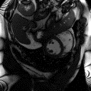
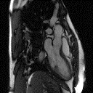
Rules
Short axis (SAX)
Rules
Long axis (LAX)
Given an input image, obtain the cardiac orientation.
Notes:
If any of you have done any programming before, you’ll know this is actually a very difficult task! How do you turn this problem into a set of simple rules such as those computers rely on?

Slide 9
def classify_cardiac_orientation(image):
# ???
return orientation

Slide 10
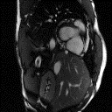
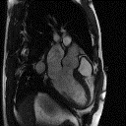
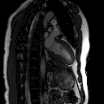
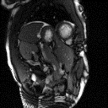
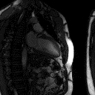
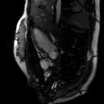
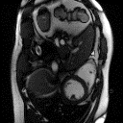
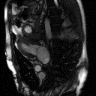
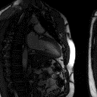
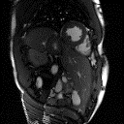
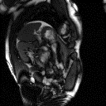
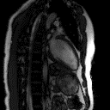
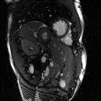
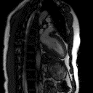
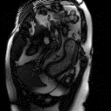
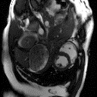
Notes:
Think about the huge variability in terms of anatomies, contrast, noise characteristics, etc.
You could easily write thousands of lines of code to create this program.
Yet humans find this task very easy. In fact, you do not even need to understand the image semantics to do this, and you certainly do not need a medical degree. In fact, you could teach a child to do this in a few minutes!

Slide 11
Data
Answers or labels
SAX
LAX
SAX
LAX
Notes:
Supervised learning, regression, classification

Slide 12
Traditional Programming
Rules
Answers
Data
Machine Learning
Answers
Rules
Data
Notes:
In traditional programming, we specify the rules that should be used to produce answers for some input data. However, what if we don’t know how to express these rules?
Well, in machine learning, we reverse rules and answers. Here we also have some data, and we know what the answer should be for a given data point. For a given short-axis image, the program should say: this is a short-axis. So we feed data and answers to the computer, and we let it infer the rules.

Slide 13
Machine learning
Artificial intelligence
Machine learning is the field of study devoted to understanding and building methods that leverage data in order to perform certain tasks.
In machine learning, we fit a model to some sample data, and then we can use that model to make predictions on new data.
In this talk, we will focus on artificial neural networks, which are a powerful type of machine learning model.
Machine learning
Neural networks
Notes:
In traditional programming, we specify the rules that should be used to produce answers for some input data. However, what if we don’t know how to express these rules?
Well, in machine learning, we reverse rules and answers. Here we also have some data, and we know what the answer should be for a given data point. For a given short-axis image, the program should say: this is a short-axis. So we feed data and answers to the computer, and we let it infer the rules.

Slide 14





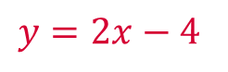
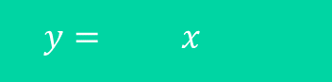

inputs
model
labels
$$y= x$$
X: 0, 1, 2, 3, 4, 5
$$y=2x−4$$
Y: -4, -2, 0, 2, 4, 6
$$w +b$$
$$2 −4$$
$$−0.4 +0$$
$$−1 +1$$
$$0.2 −1$$
parameters
Training a neural network
$$y=2x−4$$
guess
loss function
update
compare
optimizer
True
Model
Notes:
TODO: epochs

Slide 15
Training neural networks
How many times do we need to repeat this cycle?
Usually, thousands or millions. This is why we need so many computational resources!
X: 0, 1, 2, 3, 4, 5
Y: -4, -2, 0, 2, 4, 6
What happens when we run out of data?
We simply take a second look at each example. And then a third. And so on…
A full pass through the entire dataset is called an epoch. We usually train for dozens to hundreds of epochs.
guess
update
compare
Do we always look at one example at a time?
Not necessarily. We often look at several examples during each pass through the cycle. The set of examples we use during one pass is called is called a batch.
Notes:
TODO: epochs

Slide 16
Hands-on: Linear regression

Slide 17
import tensorflow as tf
x = tf.constant([0, 1, 2, 3, 4, 5], dtype=tf.float32)
y = tf.constant([-4, -2, 0, 2, 4, 6], dtype=tf.float32)
model = tf.keras.Sequential([
tf.keras.layers.Dense(units=1, input_shape=[1])
])
model.compile(optimizer='sgd', loss='mean_squared_error')
history = model.fit(x, y, epochs=1000)

Slide 18
import matplotlib.pyplot as plt
plt.plot(history.history['loss'])

Slide 19
Introduction to neural networks

Slide 20
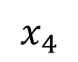
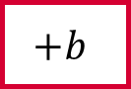
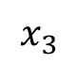
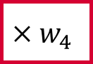
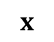
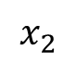

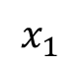
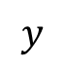


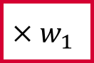

An artificial neuron
inputs
weights
neuron or unit
age
$$x_{1}$$
$$×w_{1}$$
$$×w_{2}$$
output
salt intake
$$x_{2}$$
$$+b$$
$$h$$
$$y$$
blood pressure
body mass index
$$x_{3}$$
$$×w_{3}$$
bias
activation function
alcohol intake
$$x_{4}$$
$$×w_{4}$$
$$x$$
$$w$$
$$y=h\left(w⋅x+b\right)$$
$$y=h\left(w_{1}x_{1}+w_{2}x_{2}+w_{3}x_{3}+w_{4}x_{4}+b\right)$$
$$y=w_{1}x_{1}+w_{2}x_{2}+w_{3}x_{3}+w_{4}x_{4}+b$$
$$y=w_{1}x_{1}+b$$
$$w⋅x$$

Slide 21

A neuron

Slide 22
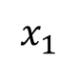
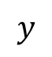
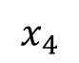
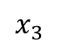
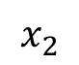
Building a neural network
input layer
hidden layer
hidden layer
output layer
age
$$x_{1}$$
output
salt intake
$$x_{2}$$
$$y$$
blood pressure
body mass index
$$x_{3}$$
alcohol intake
$$x_{4}$$
dense or fully-connected layers

Slide 23
An artificial neuron
inputs
weights
neuron or unit
age
$$x_{1}$$
$$×w_{1}$$
$$×w_{2}$$
output
salt intake
$$x_{2}$$
$$+b$$
$$h$$
$$y$$
blood pressure
body mass index
$$x_{3}$$
$$×w_{3}$$
bias
activation function
alcohol intake
$$x_{4}$$
$$×w_{4}$$
$$x$$
$$w$$
$$y=h\left(w⋅x+b\right)$$

Slide 24
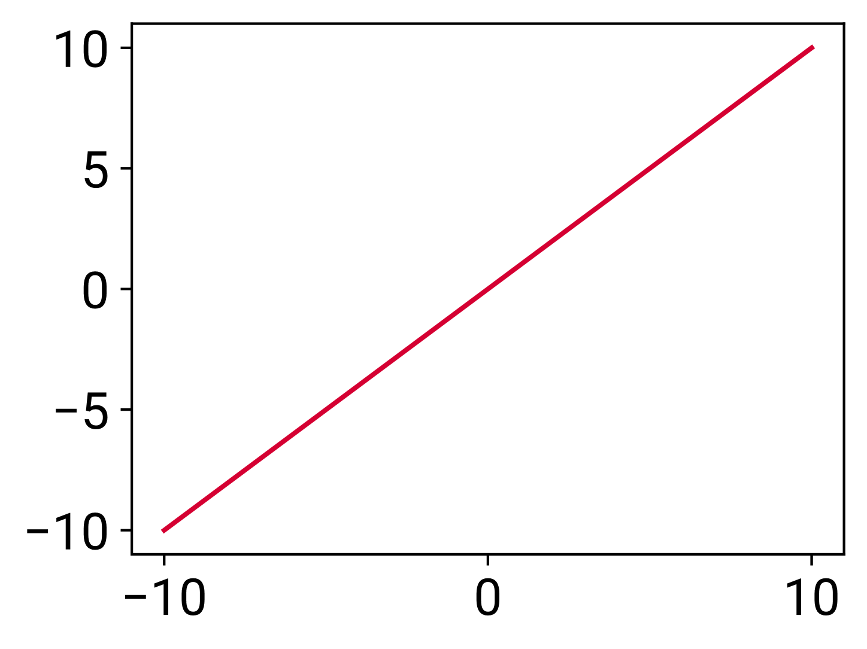
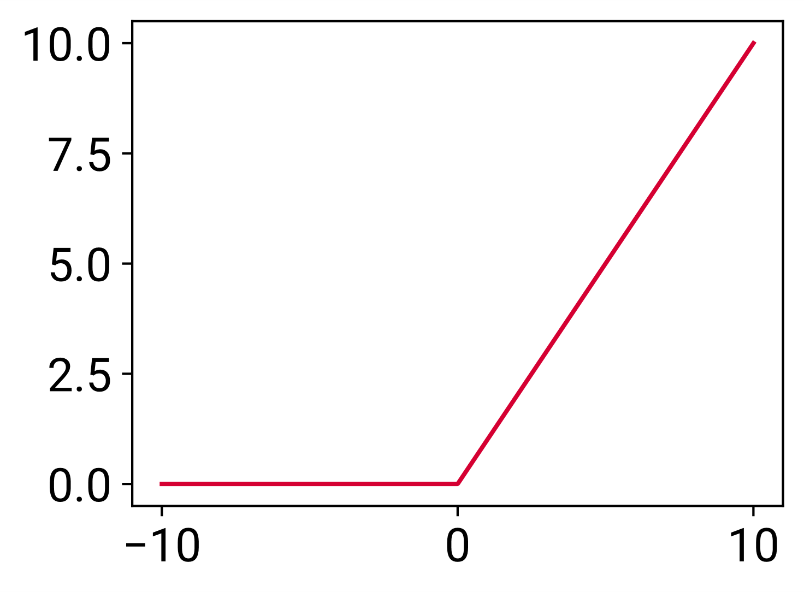
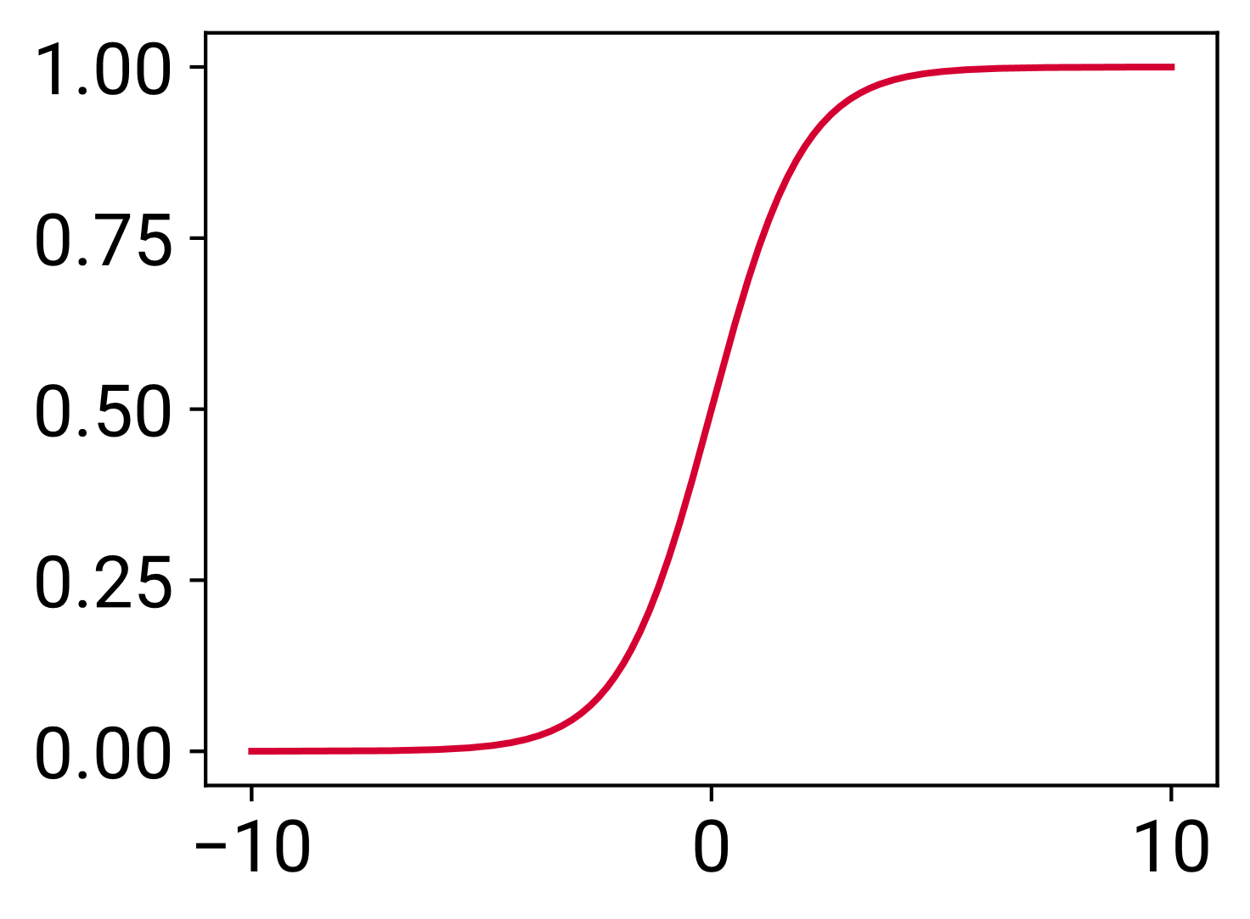

Activation functions
An activation function defines the output of a neuron.
linear
rectified linear unit (ReLU)
logistic or sigmoid
Only nonlinear activation functions enable neural networks to learn nontrivial relationships!

Slide 25
Building a neural network
input layer
hidden layer
hidden layer
output layer
age
$$x_{1}$$
output
salt intake
$$x_{2}$$
$$y$$
blood pressure
body mass index
$$x_{3}$$
alcohol intake
$$x_{4}$$
dense or fully-connected layers

Slide 26
Hyperparameters
There are many ways to configure the model and/or the training process.
How many hidden layers should we use?
How many neurons in each layer?
These values are called hyperparameters and they cannot be learned.
Usually we define them manually, and we experiment with different combinations to see what works best.

Slide 27
What about image inputs?
input layer
hidden layer
hidden layer
output layer
pixel 1
$$x_{1}$$
output
pixel 2
$$x_{2}$$
$$y$$
cardiac orientation
pixel 3
$$x_{3}$$
pixel 4
$$x_{4}$$
dense or fully-connected layers

Slide 28
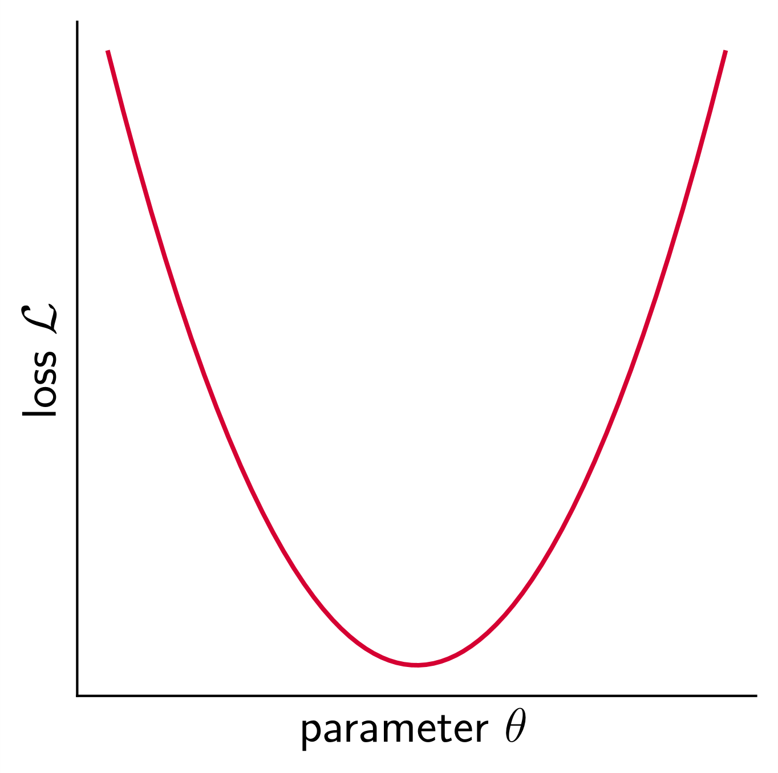
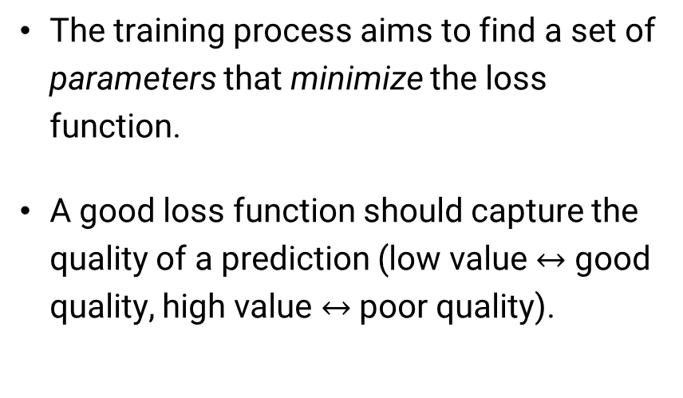
Loss functions
The loss function represents the cost associated with a model’s predictions.
The training process aims to find a set of parameters that minimize the loss function.
A good loss function should capture the quality of a prediction (low value $↔$ good quality, high value $↔$ poor quality).

Slide 29
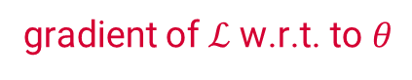
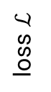
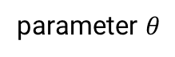
The role of gradients
The gradient always points in the direction in which a function rises most steeply.
Gradients drive parameter updates and play a crucial role in training neural networks.
For this to be possible, neural networks must use functions for which a gradient exists. Such functions are said to be differentiable.
Fortunately, gradients can be easily computed for many functions.
–
gradient of $ℒ$ w.r.t. to $θ$
loss $ℒ$
parameter $θ$

Slide 30
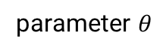
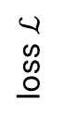
The gradient descent algorithm
The gradient descent algorithm is an iterative method to find the minimum of a differentiable function.
In each iteration, the algorithm takes a step towards the minimum.
The size of the steps is proportional to the gradient and to a parameter called learning rate.
loss $ℒ$
parameter $θ$

Slide 31
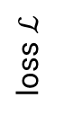
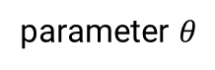
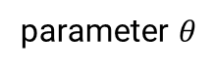
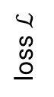
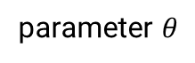
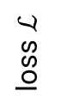
The effect of the learning rate
too small
good
too large
loss $ℒ$
loss $ℒ$
loss $ℒ$
parameter $θ$
parameter $θ$
parameter $θ$
The learning rate can have a very large impact on final model performance. It should always be chosen appropriately.

Slide 32
Common loss functions
Which loss function is appropriate depends on the task. Some of the most common include:
Mean squared error (regression tasks).
Cross-entropy (classification tasks). Can be binary (binary classification) or categorical (multiclass classification).
Notes:
TODO: epochs

Slide 33
inputs
neural network or model
labels
$$y= x$$
X: 0, 1, 2, 3, 4, 5
$$y=2x−4$$
Y: -4, -2, 0, 2, 4, 6
$$w +b$$
$$−1 +1$$
Training a neural network
guess
loss function
(e.g. MSE)
update
compare
optimizer
(e.g. SGD)
True
Model
Notes:
TODO: epochs

Slide 34
Optimizers
An optimizer is an algorithm that specifies how to update the model’s parameters at each training iteration.
All optimizers use the gradient of the loss w.r.t. to each parameter.
The most basic optimizer (stochastic gradient descent) simply updates the weights in the direction of the gradient with a fixed step size (learning rate).
Better optimizers may also remember previous iterations and/or adapt their step size (e.g., Adam).
Notes:
TODO: epochs

Slide 35
Batches
Neural networks usually process training examples in batches.
A batch is a set of examples which are used to estimate the loss and gradients during a training iteration. The network’s parameters are updated once for each batch.
Smaller batches result in noisier updates, but each iteration has a lower cost.

Slide 36

https://playground.tensorflow.org/

Slide 37
Data and generalization

Slide 38
The importance of data
Machine learning works by fitting a model to some data. Therefore, the availability of data is essential to success.
In general, having more data allows us to build better models.
Data quality (e.g., correct labels) is also very important, especially when the total amount of data is not very large.
In medical imaging, training datasets are often relatively small (typically in the range of hundreds or a few thousand examples).
There are techniques that help us make the most of the available data, such as data augmentation. You will learn more about these in the next sessions.

Slide 39










Generalization
To be useful, models need to generalize to previously unseen data.

Slide 40
The bias-variance trade-off
We want the model to capture important regularities in the data while discarding noisy or unrepresentative information. The trade-off between these two requirements is called the bias-variance trade-off.
underfitting
good balance
overfitting

Slide 41

Training and test sets
The data we use to train a model is referred to as the training set.
We must always evaluate models using a test set which is independent from the training set.
training set
test set
train
evaluate

Slide 42


Why we need a validation set
training set
test set
validation set
test set
train
evaluate
evaluate
information is leaking from the test set!

Slide 43
Training, validation and test datasets
training set
validation set
test set
used to fit the model’s parameters
used to optimize the model during development
used to provide an unbiased evaluation of the final model

Slide 44
Splitting the data
Usually we only have one dataset, and it is up to us to split it into a training set, a validation set and a test set.
It is common to see train-validation-test splits such as 80-10-10% or 70-10-20%, but this depends on the problem.
We need enough validation/test data to evaluate our model with confidence, but we also want to maximise the amount of training data.
For very large datasets, the proportion used for training is typically larger (e.g. 98-1-1%).

Slide 45
Splitting the data
Typically, the best approach is to perform the split randomly.
But sometimes we might want to take special care, e.g., to ensure adequate representation of different subgroups within each dataset.
We must ensure that the resulting datasets are truly independent.
For example, medical images from the same patient should all be assigned to the same dataset.

Slide 46

Data scope
The datasets must be representative of the population in which a model is to be used.

Slide 47
Data scaling
Neural networks are sensitive to the scale of their inputs and outputs.
Inappropriate scaling can make the learning process difficult or unstable.
A good rule of thumb is that input and output values should be small, around [0, 1] or [-1, 1].
In the case of outputs, the data range must match that of the

Slide 48

Data scaling
Normalization maps the minimum input value to 0 and the maximum input value to 1. It is very common to do this when processing images, which often come in the range [0, 255] (natural images) or [0, 4095] or [-2048, 2047] (DICOM).
$$x=\frac{x−\min\left(x\right)}{\max\left(x\right)−\min\left(x\right)}$$
pixel values in range [0, 4095]
pixel values in range [0, 1]
divide by 4095

Slide 49

Data scaling
Another common preprocessing operation is standardization, which rescales the input values to have zero mean and unit variance. This is well suited to normally distributed data.
$$x=\frac{x−\operatorname{mean}\left(x\right)}{\operatorname{std}\left(x\right)}$$

Slide 50


Data preprocessing
Some preprocessing operations, such as rescaling, may be performed at an instance level or a dataset level.
instance level
dataset level
we only look at the current example to apply the operation
we look at the entire dataset to apply the operation
easier to implement changes the relationship between examples
harder to implement the relationship between examples does not change

Slide 51
Data preprocessing
We often need to transform data prior to processing by a neural network.
A common transformation is data scaling. This is important because neural networks are sensitive to the scale of their inputs and outputs. A good rule of thumb is that input and output values should be small, around [0, 1] or [-1, 1].
pixel values in range [0, 255]
pixel values in range [0, 1]
divide by 255

Slide 52







Categorical variables
Sometimes input and/or output variables are categorical. Categorical variables take one of several possible values, which do not need to be numeric.
However, deep learning algorithms are designed to operate on continuous, numeric data.
one-hot encoding
$$p_{rock}$$
$$p_{paper}$$
$$p_{scissors}$$
set the $p$ for the correct class to 1, and the rest to 0
[ 1 , 0 , 0 ]
“paper”
“scissors”
“rock”
1
2
0
[ 0 , 1 , 0 ]
[ 0 , 0 , 1 ]

Slide 53
Predicting probability distributions
The logits are the raw (non-normalized) predictions of a neural network.
The softmax function can be used to normalize the logits to a probability distribution over the predicted output classes.
logits
probabilities
labels
1.8
0.06
0
softmax
4.5
0.85
1
2.2
0.09
0
loss (e.g., categorical cross-entropy)

Slide 54
Fashion MNIST

Slide 55
Fashion MNIST
T-shirt/top
T-shirt/top
dress
pullover
sneaker
pullover
sandal
sandal
ankle boot
sneaker
trouser
shirt
coat
dress
trouser
coat
bag
shirt
bag
ankle boot
trouser

Slide 56
Fashion MNIST
Label | Description
0 | T-shirt/top
1 | Trouser
2 | Pullover
3 | Dress
4 | Coat
5 | Sandal
6 | Shirt
7 | Sneaker
8 | Bag
9 | Ankle boot
Training set: 60,000 examples
Test set: 10,000 examples
28 × 28 images
10 classes, labelled 0 to 9

Slide 57
Hands-on: Image classification using a dense neural network

Slide 58
import tensorflow as tf
(train_images, train_labels), (test_images, test_labels) = (
tf.keras.datasets.fashion_mnist.load_data())
# Normalize the images to the range [0, 1].
train_images = train_images.astype("float32") / 255
test_images = test_images.astype("float32") / 255
# Transform labels using one-hot encoding
# (e.g., 2 -> [0, 0, 1, 0, 0, 0, 0, 0, 0, 0]).
train_labels = tf.one_hot(train_labels, depth=10)
test_labels = tf.one_hot(test_labels, depth=10)

Slide 59
model = tf.keras.Sequential([
tf.keras.layers.Flatten(input_shape=[28, 28]),
tf.keras.layers.Dense(units=128, activation='relu’),
tf.keras.layers.Dense(units=10, activation='softmax')
])
model.compile(optimizer='adam',
loss='categorical_crossentropy',
metrics=['accuracy'])
history = model.fit(train_images, train_labels, epochs=10)
model.evaluate(test_images, test_labels)

Slide 60
Epoch 1/10
1875/1875 [==============================] - 2s 802us/step - loss: 0.7430 - accuracy: 0.7596
Epoch 2/10
1875/1875 [==============================] - 1s 794us/step - loss: 0.5110 - accuracy: 0.8260
Epoch 3/10
1875/1875 [==============================] - 2s 805us/step - loss: 0.4654 - accuracy: 0.8390
Epoch 4/10
1875/1875 [==============================] - 2s 802us/step - loss: 0.4396 - accuracy: 0.8480
Epoch 5/10
1875/1875 [==============================] - 2s 802us/step - loss: 0.4221 - accuracy: 0.8541
Epoch 6/10
1875/1875 [==============================] - 2s 808us/step - loss: 0.4078 - accuracy: 0.8581
Epoch 7/10
1875/1875 [==============================] - 2s 802us/step - loss: 0.3964 - accuracy: 0.8624
Epoch 8/10
1875/1875 [==============================] - 2s 808us/step - loss: 0.3861 - accuracy: 0.8661
Epoch 9/10
1875/1875 [==============================] - 2s 803us/step - loss: 0.3775 - accuracy: 0.8685
Epoch 10/10
1875/1875 [==============================] - 2s 810us/step - loss: 0.3705 - accuracy: 0.8706
313/313 [==============================] - 0s 877us/step - loss: 0.4293 - accuracy: 0.8443

Slide 61
Introduction to convolutional neural networks

Slide 62





input layer
hidden layer
hidden layer
output layer
pixel 1
$$x_{1}$$
output
pixel 2
$$x_{2}$$
$$y$$
pixel 3
$$x_{3}$$
pixel 4
$$x_{4}$$
dense or fully-connected layers

Slide 63

Two new layer types
The two main components of convolutional neural networks are convolutional layers and pooling layers.
These are loosely inspired by the structure of the visual cortex.

Slide 64



The convolution operation

Slide 65

Introducing convolutions

Slide 66







The convolution operation
$$−1×0+0×0+1×1 \\ −1×0+0×0+1×0$$
$$−1×1+0×1+1×1$$
$$=1$$
filter
image
filtered image

Slide 67

The convolution operation
filter
image
filtered image

Slide 68

The convolution operation
filter
image
filtered image

Slide 69



The convolution operation
image
filtered image

Slide 70
The convolution operation
-1 | 0 | 1
-1 | 0 | 1
-1 | 0 | 1
convolve
image
features
This is a vertical edge detector!

Slide 71
Feature extraction
? | ? | ?
? | ? | ?
? | ? | ?
?
-1 | 0 | 1
-1 | 0 | 1
-1 | 0 | 1
-1 | -1 | -1
0 | 0 | 0
1 | 1 | 1
-2 | 4 | -5
2 | 4 | -3
1 | 0 | -4
0 | 2 | 1
-5 | -2 | -5
-1 | 2 | 1
convolve
image
features

Slide 72




The pooling operation
image
downsampled image

Slide 73

The pooling operation
image
downsampled image

Slide 74

The pooling operation
image
downsampled image

Slide 75



The pooling operation
image
downsampled image

Slide 76

Building a convolutional neural network
higher resolution
higher level semantics
4 feature maps or channels
8 feature maps
conv
pool
conv
pool
? | ? | ?
? | ? | ?
? | ? | ?
filter or kernel
? | ? | ?
? | ? | ?
? | ? | ?
? | ? | ?
? | ? | ?
? | ? | ?
? | ? | ?
? | ? | ?
? | ? | ?
× 4 filters
? | ? | ?
? | ? | ?
? | ? | ?
× 8 filters
kernel size
trainable parameters

Slide 77

Hierarchical representations
shallow layers
low-level features
intermediate layers
mid-level features
deep layers
high-level features
Adapted from Lee et al. (2011). Unsupervised Learning of Hierarchical Representations with Convolutional Deep Belief Networks.

Slide 78

A convolutional classifier
Conv
Conv
Dense
Conv
Dense
Conv
Pooling
Pooling
Conv
Conv
Pooling
SAX
feature extraction
classification

Slide 79
Convolutional vs dense layers
each output pixel depends on every input pixel
each output pixel has its own weights
# parameters: (128 × 128) × (128 × 128) = 268 M
dense
each output pixel depends only on its neighbours
different output pixels share weights
# parameters: 3 × 3 = 9
convolutional
Convolutions have inherent biases which make them a very efficient choice for image processing.

Slide 80
Hands-on: Image classification with convolutional neural networks

Slide 81
import tensorflow as tf
(train_images, train_labels), (test_images, test_labels) = (
tf.keras.datasets.fashion_mnist.load_data())
# Normalize the images to the range [0, 1].
train_images = train_images.astype("float32") / 255
test_images = test_images.astype("float32") / 255
# Transform labels using one-hot encoding
# (e.g., 2 -> [0, 0, 1, 0, 0, 0, 0, 0, 0, 0]).
train_labels = tf.one_hot(train_labels, depth=10)
test_labels = tf.one_hot(test_labels, depth=10)
# Add a channel dimension [28, 28] -> [28, 28, 1].
train_images = tf.expand_dims(train_images, axis=-1)
test_images = tf.expand_dims(test_images, axis=-1)

Slide 82
model = tf.keras.Sequential([
tf.keras.Input(shape=(28, 28, 1)),
tf.keras.layers.Conv2D(filters=32, kernel_size=(3, 3), activation="relu"),
tf.keras.layers.MaxPooling2D(pool_size=(2, 2)),
tf.keras.layers.Conv2D(filters=64, kernel_size=(3, 3), activation="relu"),
tf.keras.layers.MaxPooling2D(pool_size=(2, 2)),
tf.keras.layers.Flatten(),
tf.keras.layers.Dense(10, activation="softmax"),
])
model.compile(optimizer=tf.keras.optimizers.Adam(learning_rate=0.001),
loss="categorical_crossentropy",
metrics=["accuracy"])
history = model.fit(train_images, train_labels,
epochs=10,
validation_data=(test_images, test_labels))
model.evaluate(test_images, test_labels)

Slide 83
Epoch 1/10
1875/1875 [==============================] - 4s 1ms/step - loss: 0.4783 - accuracy: 0.8271 - val_loss: 0.3771 - val_accuracy: 0.8673
Epoch 2/10
1875/1875 [==============================] - 2s 1ms/step - loss: 0.3276 - accuracy: 0.8806 - val_loss: 0.3303 - val_accuracy: 0.8845
Epoch 3/10
1875/1875 [==============================] - 2s 1ms/step - loss: 0.2851 - accuracy: 0.8961 - val_loss: 0.3195 - val_accuracy: 0.8848
Epoch 4/10
1875/1875 [==============================] - 2s 1ms/step - loss: 0.2574 - accuracy: 0.9067 - val_loss: 0.2863 - val_accuracy: 0.8970
Epoch 5/10
1875/1875 [==============================] - 2s 1ms/step - loss: 0.2364 - accuracy: 0.9143 - val_loss: 0.2806 - val_accuracy: 0.8995
Epoch 6/10
1875/1875 [==============================] - 2s 1ms/step - loss: 0.2176 - accuracy: 0.9215 - val_loss: 0.2648 - val_accuracy: 0.9054
Epoch 7/10
1875/1875 [==============================] - 2s 1ms/step - loss: 0.2012 - accuracy: 0.9262 - val_loss: 0.2616 - val_accuracy: 0.9051
Epoch 8/10
1875/1875 [==============================] - 2s 1ms/step - loss: 0.1903 - accuracy: 0.9307 - val_loss: 0.2582 - val_accuracy: 0.9079
Epoch 9/10
1875/1875 [==============================] - 3s 1ms/step - loss: 0.1784 - accuracy: 0.9354 - val_loss: 0.2644 - val_accuracy: 0.9078
Epoch 10/10
1875/1875 [==============================] - 3s 1ms/step - loss: 0.1681 - accuracy: 0.9383 - val_loss: 0.2712 - val_accuracy: 0.9052
313/313 [==============================] - 0s 1ms/step - loss: 0.2712 - accuracy: 0.9052

Slide 84
import matplotlib.pyplot as plt
fig, ax = plt.subplots(1, 2)
ax[0].plot(history.history['loss'], label='train')
ax[0].plot(history.history['val_loss'], label='test')
ax[1].plot(history.history['accuracy'], label='train')
ax[1].plot(history.history['val_accuracy'], label='test')

Slide 85
Where to go next
SCMR Series of Hands-on Workshops on Machine Learning
A Classification Task in CHD
August 31st, 2022 • 17:00 BST Dr Olivier Jaubert
A Segmentation Task in CHD
September 28th, 2022 • 17:00 BST Dr Saeed Karimi-Bidhendi
TensorFlow website (guide, tutorials, documentation): https://www.tensorflow.org/
TensorFlow Playground (intuition about how neural networks process the data): https://playground.tensorflow.org/

Slide 86


Thank you for your attention!
Rebecca Baker
Sheena Bhagirath
Olivier Jaubert
Saeed Karimi-Bidhendi
Dan Knight
Vivek Muthurangu
Jennifer Steeden

